Slide 1



RFM Analysis
By Laurids Klevenhaus

Slide 2


For this project I used MySQL and DBeaver to run queries…

Slide 3

…And Tableau as the visualization software

Slide 4

Project & Data Brief
Purpose: To inspect the data, do some light EDA and perform a (R)ecency (F)requency (M)onetary analysis to find out which customers are highly valuable and which customers are slipping away + visualizing data using Tableau
Data: sales_data_sample.csv
The data contains information regarding orders from a fictious retail store.
Source: https://www.kaggle.com/datasets/kyanyoga/sample-sales-data
1. Ordernumber
2. Quantityordered
3. Priceeach
4. Orderlinenumber
5. Sales
6. Orderdate
7. Status
8. Qtr_ID
9. Month_ID
10. Year_ID
11. Productline
12. MSRP
13. Productcode
14. Customername
15. Phone
16. Addressline1
17. Addressline2
18. City
19. State
20. Postalcode
21. Country
22. Territory
23. Contactlastname
24. Contactfirstname
25. Dealsize

Slide 5
Business Data Processing
1. Checking Unique Values; Inspecting data
2. Standardize Date Format; Convert ”Orderdate” into a date format
3. EDA; Sales by Productline, Sales by Year, Sales by Dealsize,
4. RFM Analysis; An indexing technique that uses past purchase behavior to segment customers.
5. Visualizing the data in Tableau;

Slide 6

1. Inspecting The Data

Slide 7
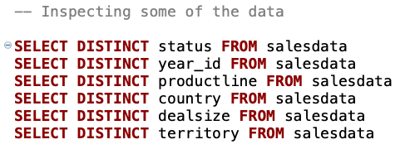
Solution

Slide 8
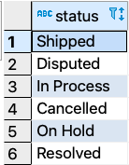
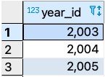
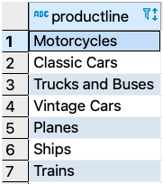
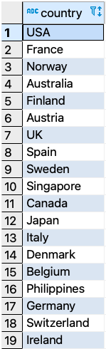
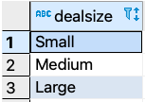
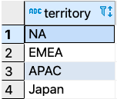
Result

Slide 9
2. Standardize Date Format

Slide 10
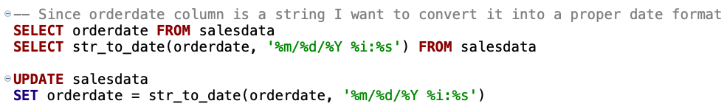
Solution

Slide 11
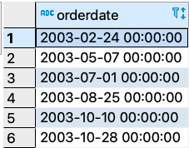
Result

Slide 12
3. EDA

Slide 13
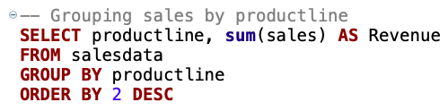
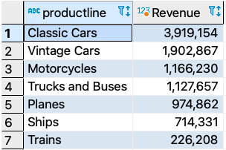
Sales by Productline

Slide 14
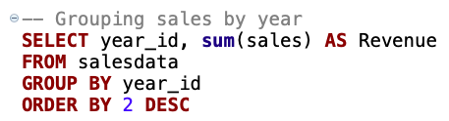
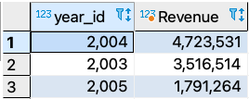
Sales by Year

Slide 15
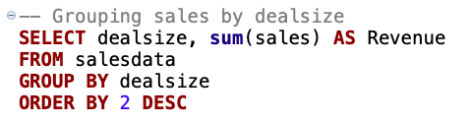
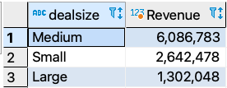
Sales by Deal Size

Slide 16
4. RFM Analysis

Slide 17
RFM Analysis
Recency– Frequency – Monetary (RFM)
It is an indexing technique that uses past pruchase behavior to segment customers.
An RFM report that is a way of segmenting customers using three key metrics:
      Recency (how long ago was their last purchase?)
      Frequency (how often do they purchase?)
      Monetary value (how much they spent?)

Slide 18
Data Points Used In RFM
Recency → Last order date
Frequency → Count of total orders made by the specific customer
Monetary value → Total spend / sales generated from the specific customer

Slide 19
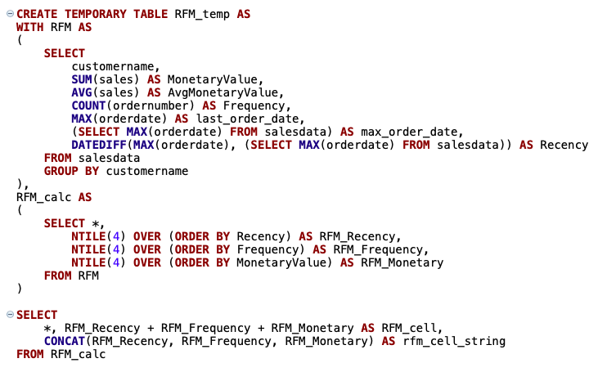
For all customers I want to find their recent orders (Recency), how many times they ordered (Frequency), and their monetary value (Monetary) using CTEs. I want to "save" this result in a temp table.
1.
2.
3.
Notes:
Some comments:
Recency: Must be found by taking the latest date in the dataset and subtract the customers’ last order date. Then we find how many days have gone since their last purchase.
NTILE partitions Recency, Frequency and Monetary into 4 bins from 1-4. E.g. a 4 in recency means that the customer made a purchase very recently.
RFM_cell is the sum of the RFM factors scores (e.g. 1+1+1 = 3). CONCAT lets me parse the scores as a string so 1+1+1 becomes 111. → This will be used for indexing next.
Result on next slide.

Slide 20
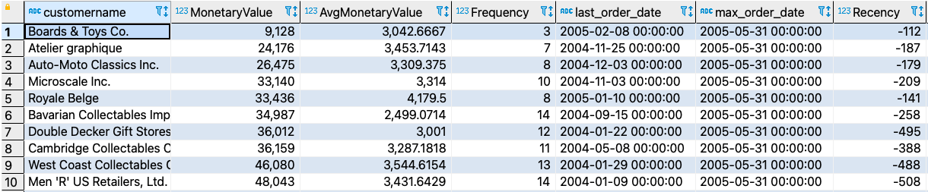
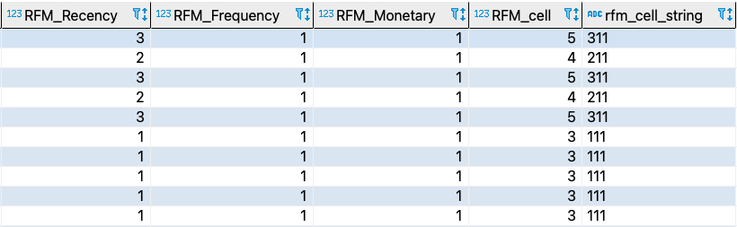
Result

Slide 21
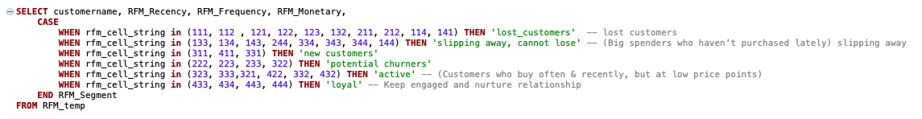
Solution
Notes:
When the rfm_cell_string from before contains the numbers in the parentheses in above query, then a column will be generated that will classify if the customer is a lost customer, slipping away, new customer, potential churner, active or loyal. This is based on the scores that the customer gets on the factors Recency, Frequency and Monetary.

Slide 22
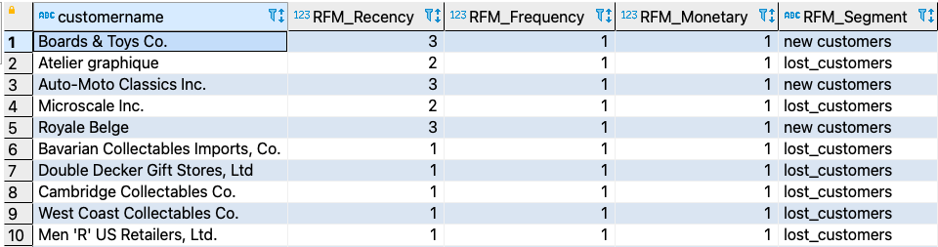
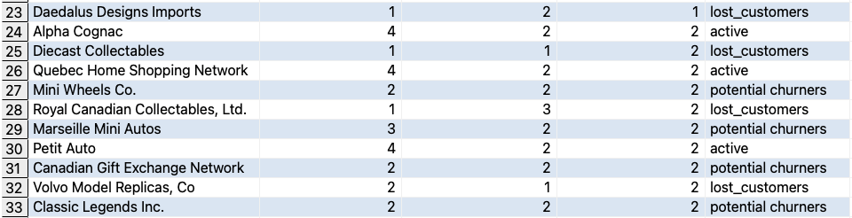
Result
Notes:
When the rfm_cell_string from before contains the numbers in the parentheses, then a column will be generated classifying if the customer is a lost customer, slipping away, new customer, potential churner, active or loyal. This is based on the scores that the customer gets on the factors Recency, Frequency and Monetary.

Slide 23
5. Visualizing The Data In Tableau

Slide 24
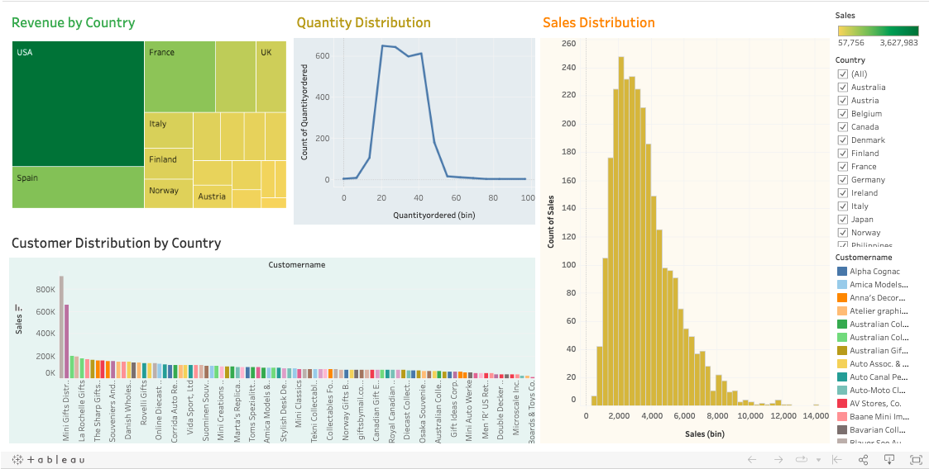
Sales Dashboard 1
Link: https://public.tableau.com/views/RFM_Sales_Dash1/RFM-SalesDashboard1?:language=en-GB&:display_count=n&:origin=viz_share_link

Slide 25
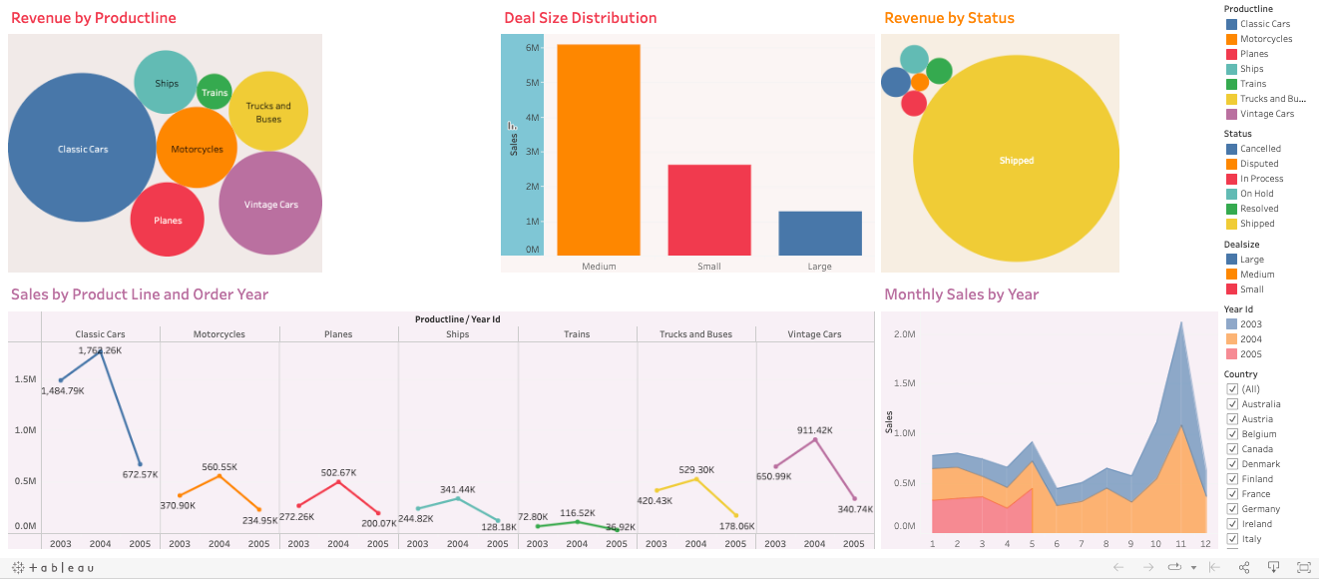
Sales Dashboard 2
Link: https://public.tableau.com/views/RFM_Sales_Dash2/RFM-SalesDashboard2?:language=en-GB&:display_count=n&:origin=viz_share_link

Slide 26



Thank You!

